Slide 1

every stitch whisper self- love
Product photo and price

Slide 2
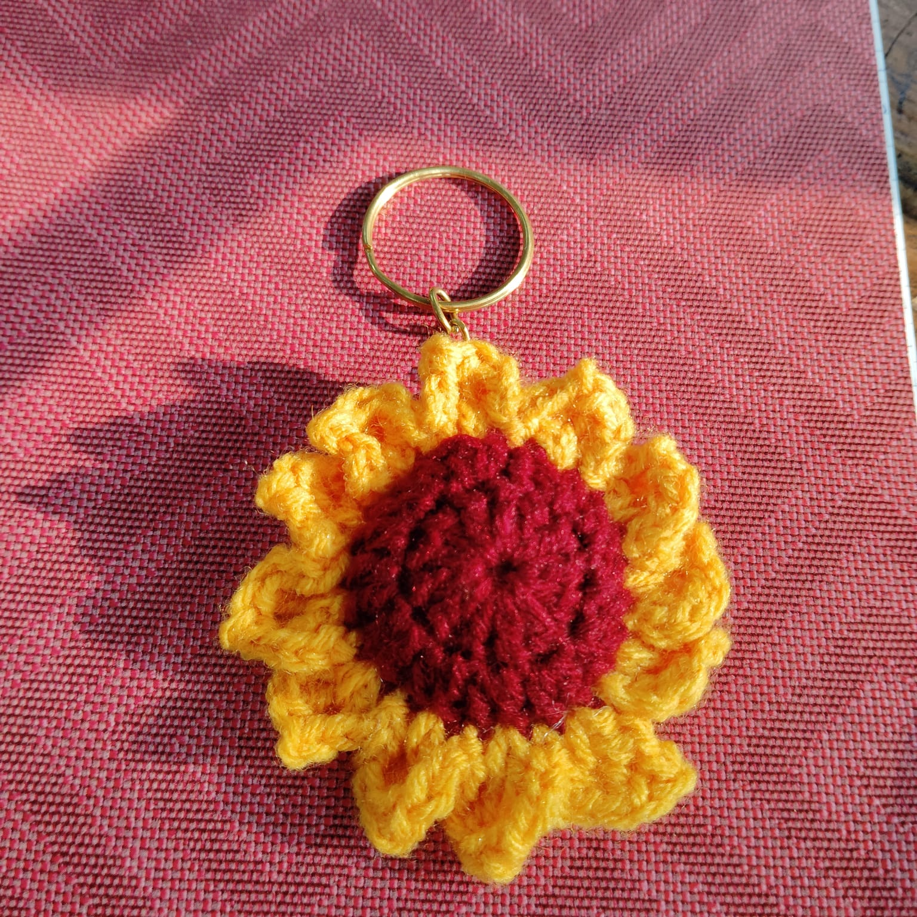
Sunflower keychain
Rs 70

Slide 3
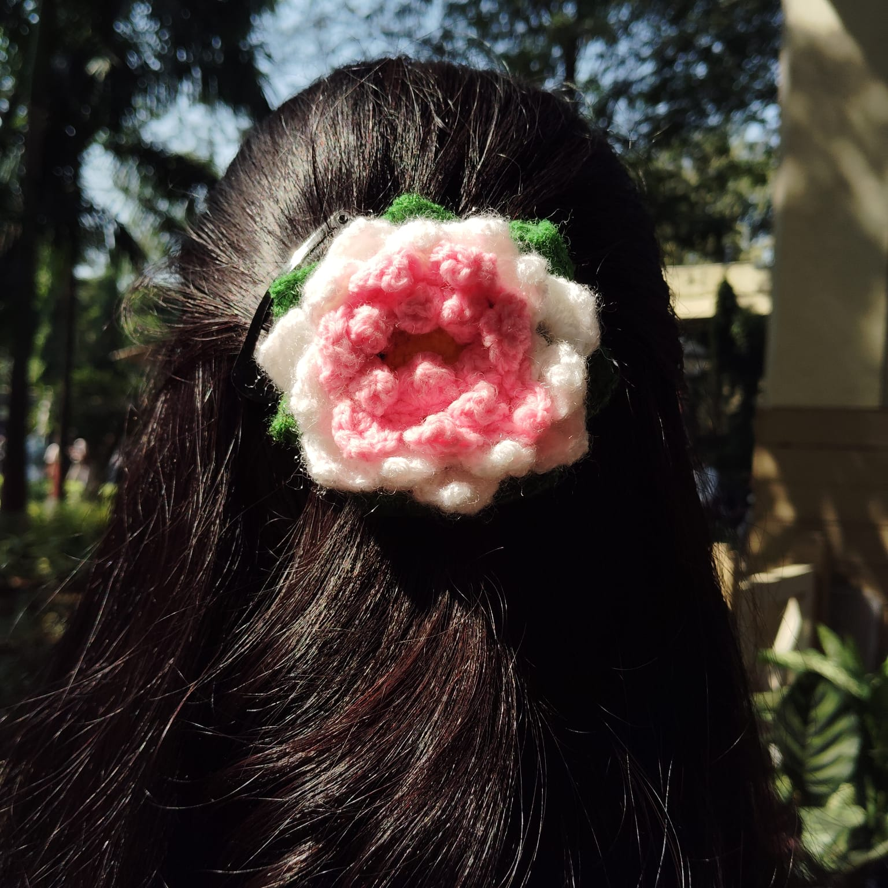
Lotus Hairclip Rs 200

Slide 4
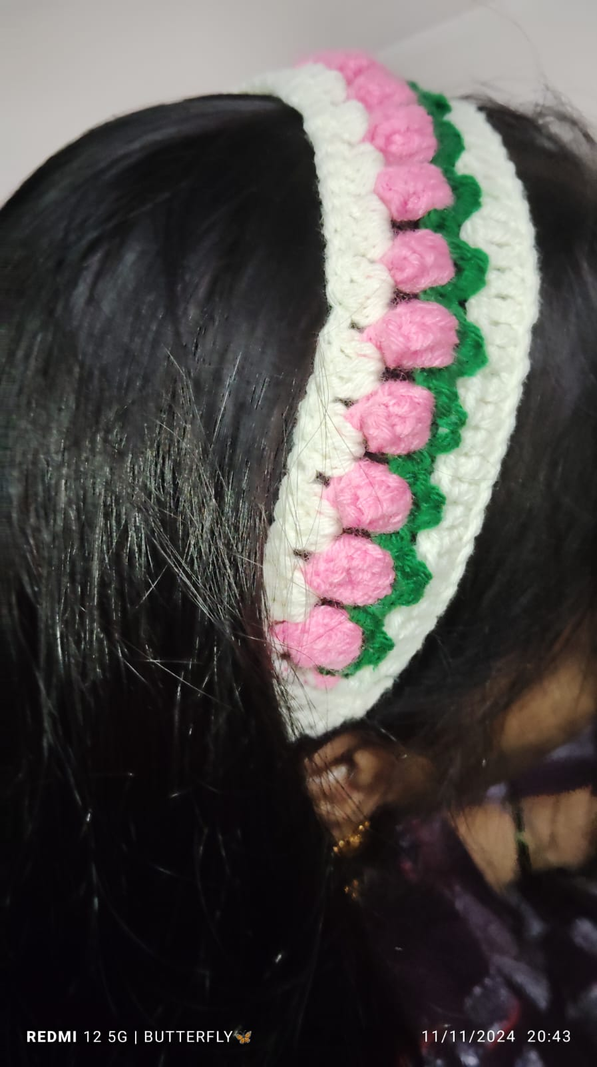
Tulip hairband Rs 150

Slide 5
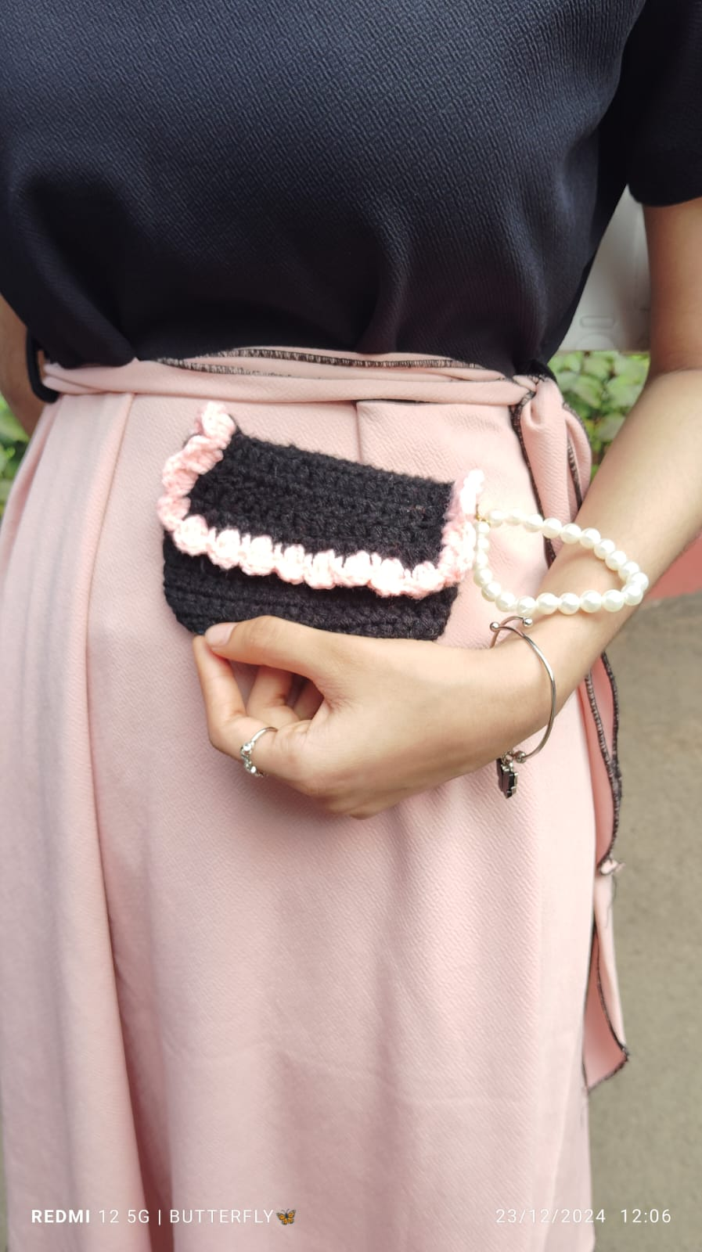
Black purse with pearl chain Rs 250

Slide 6
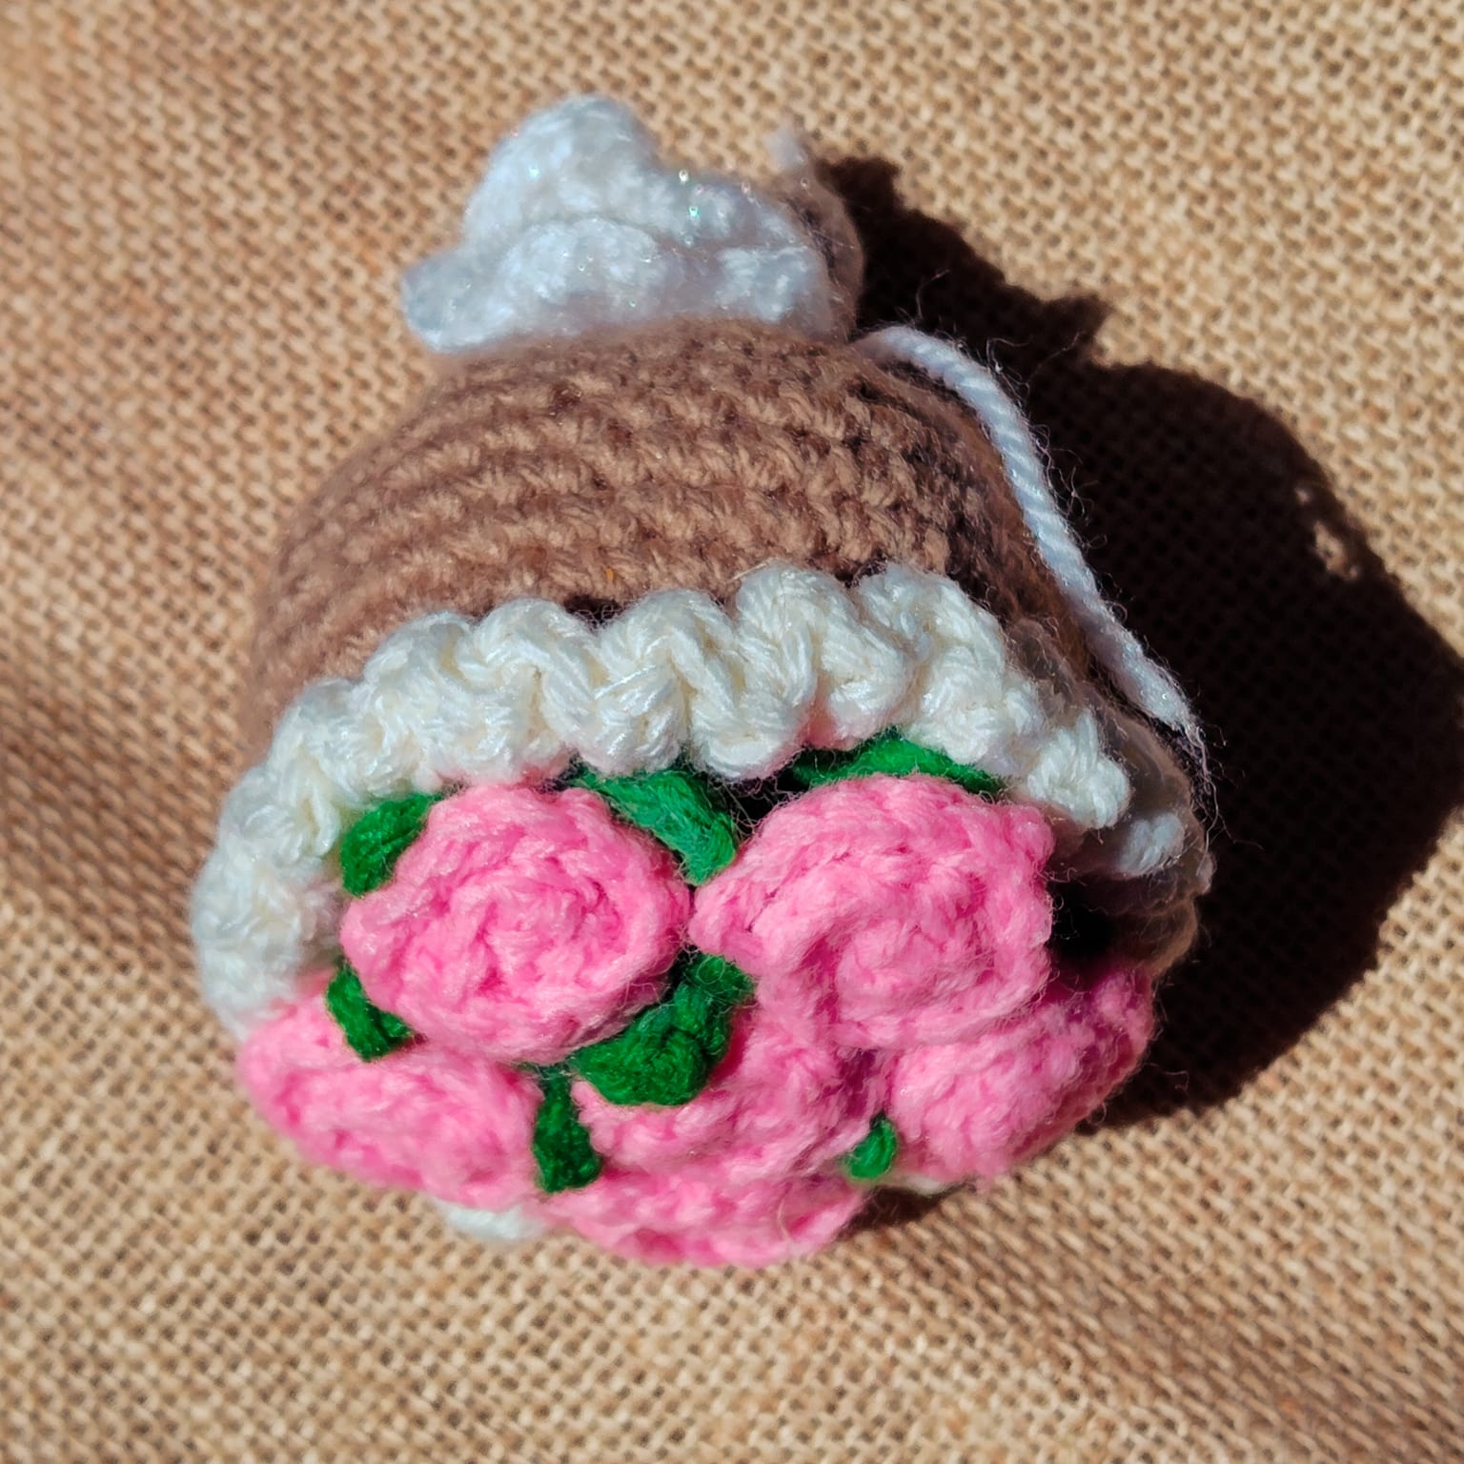
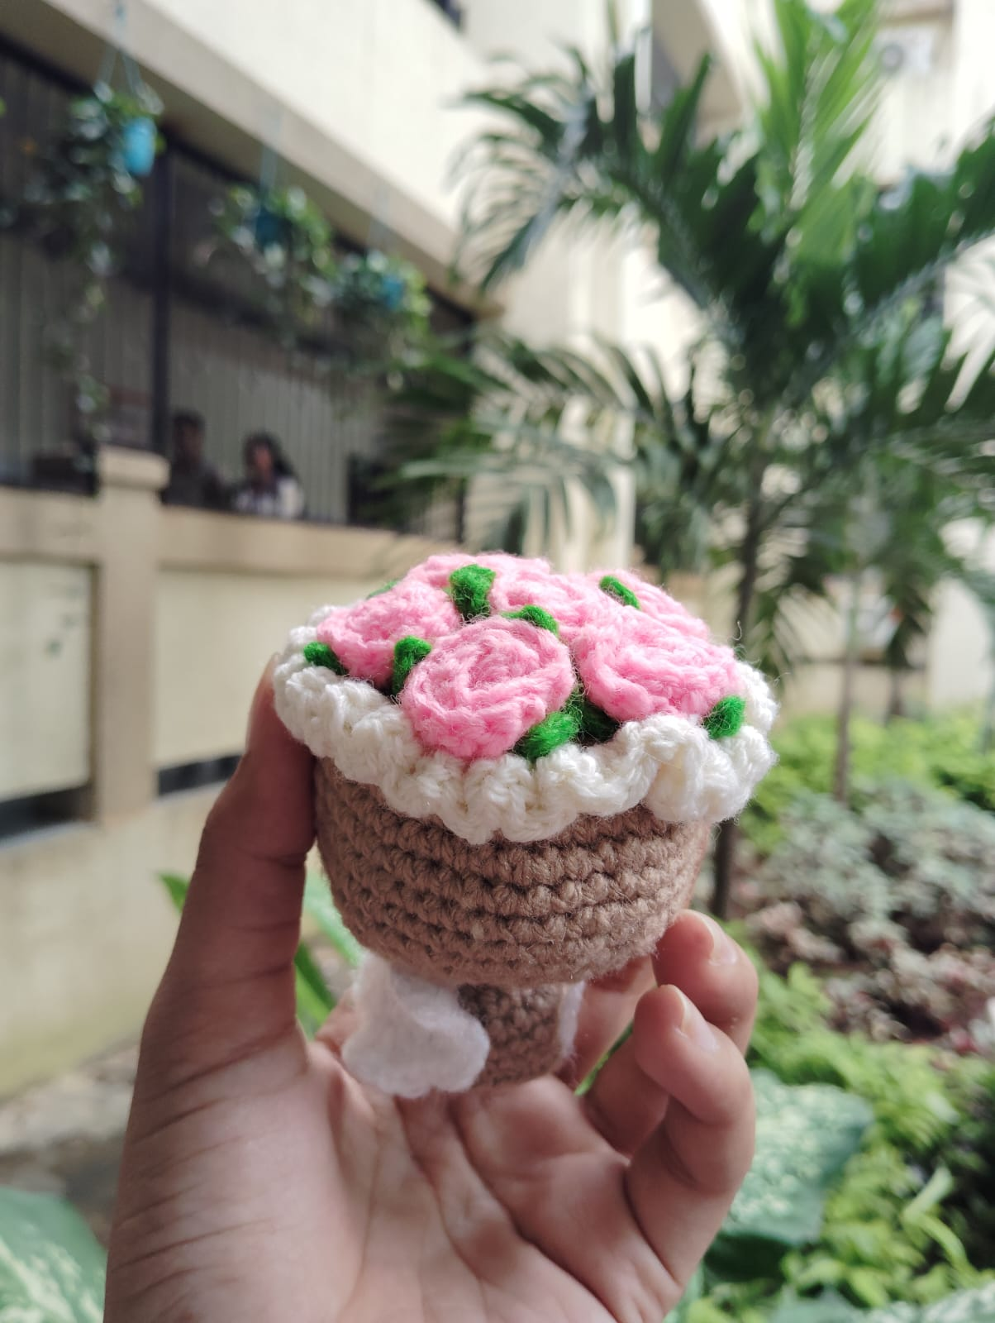
Mini Rose bouquet Rs 350

Slide 7
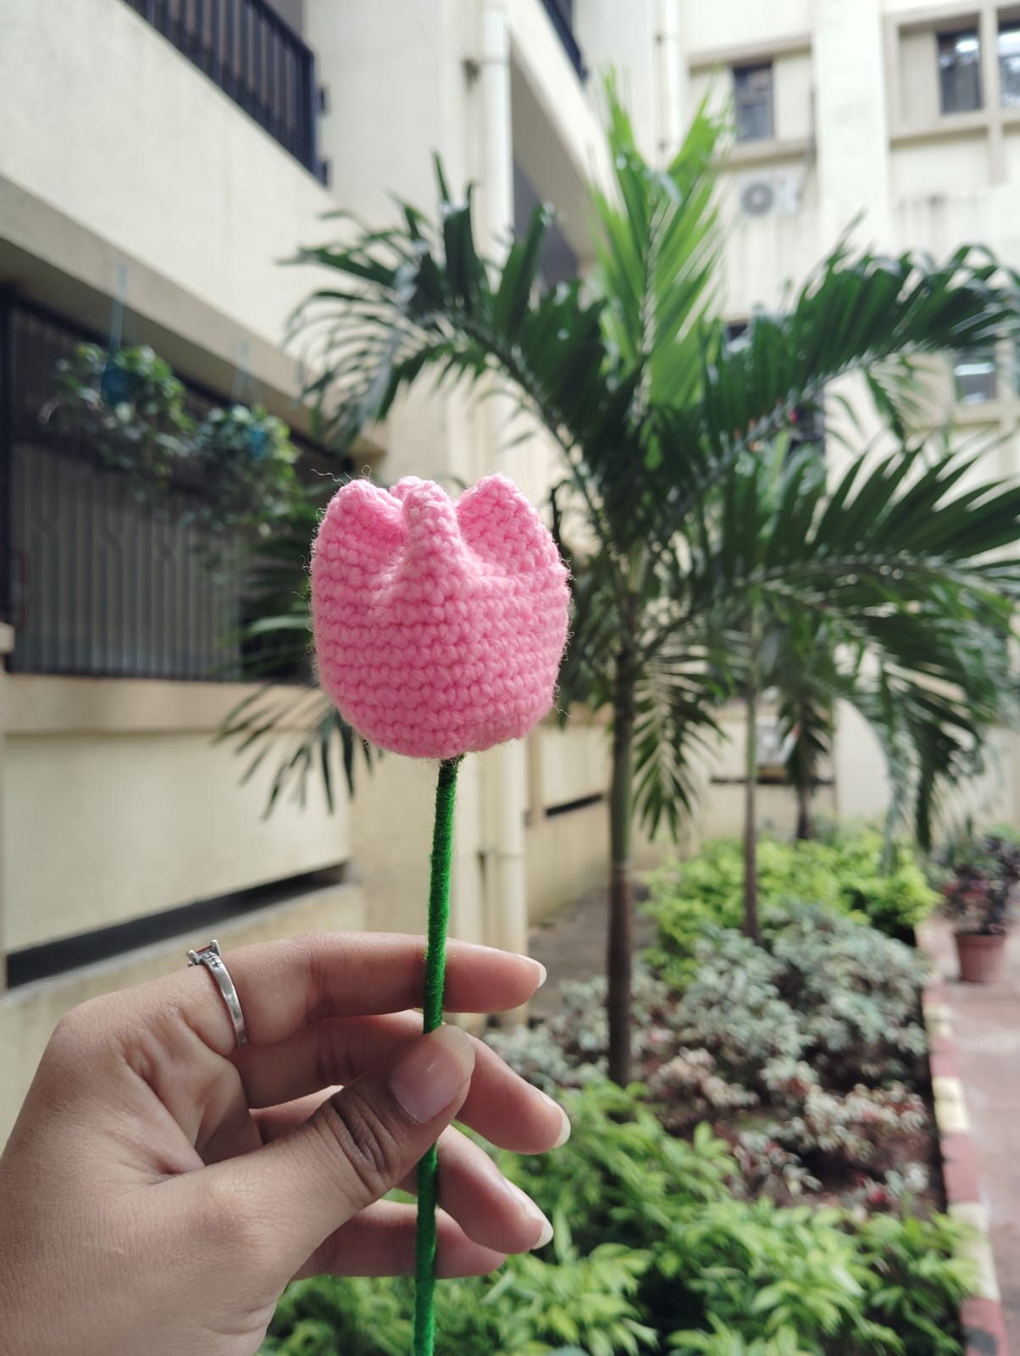
Tulip Rs 120

Slide 8
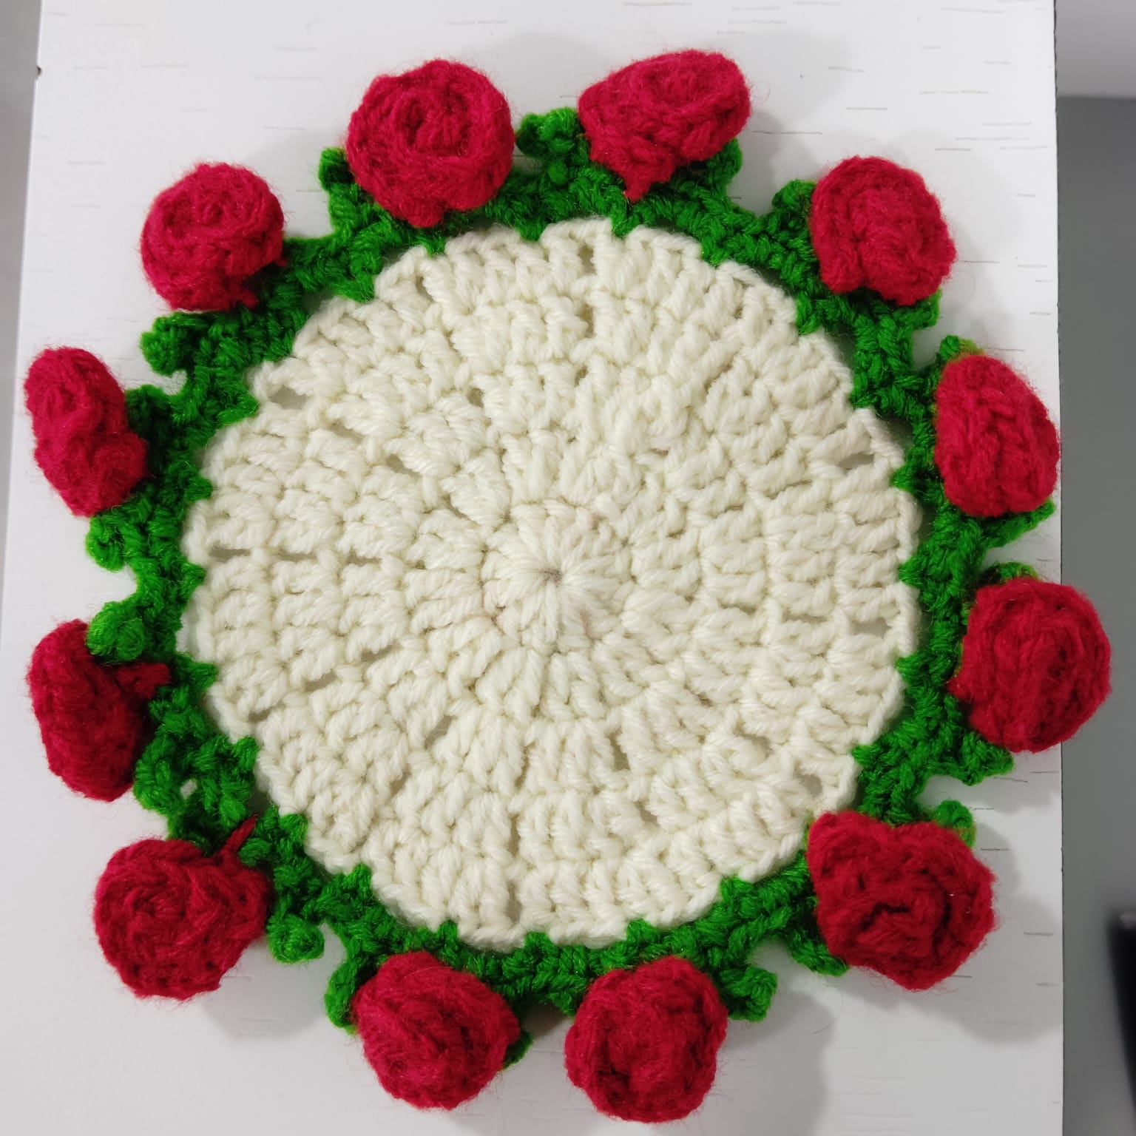
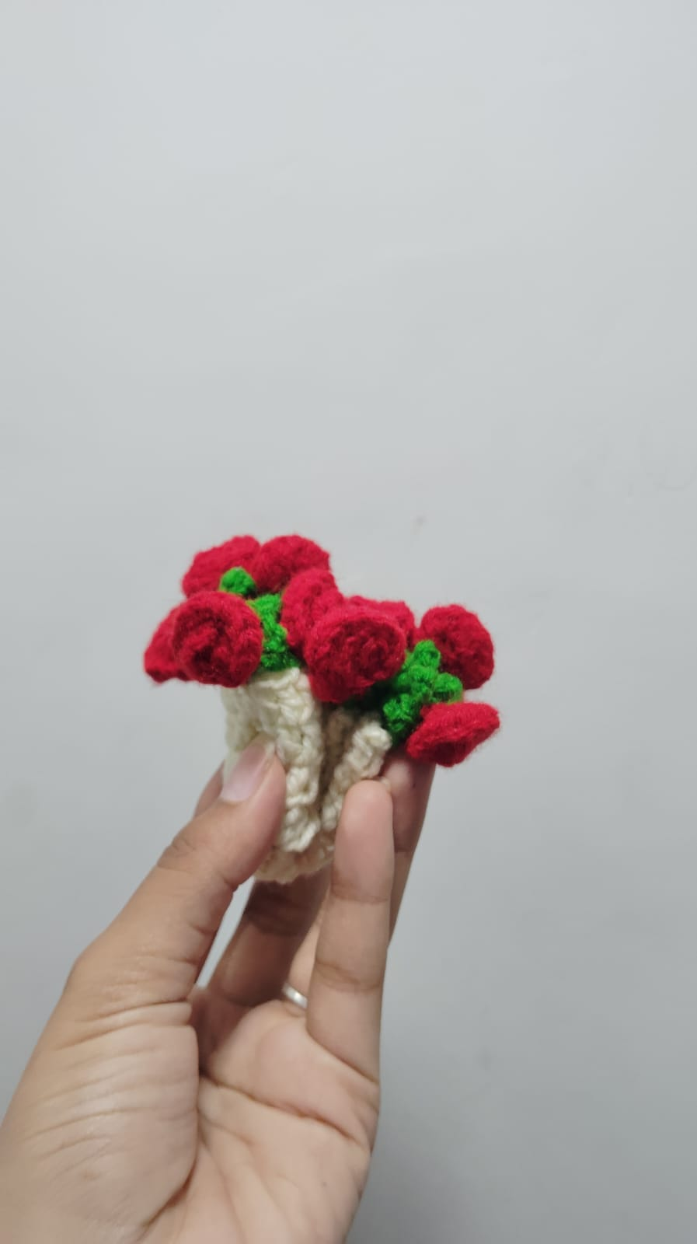
Rose Coaster Rs 250

Slide 9
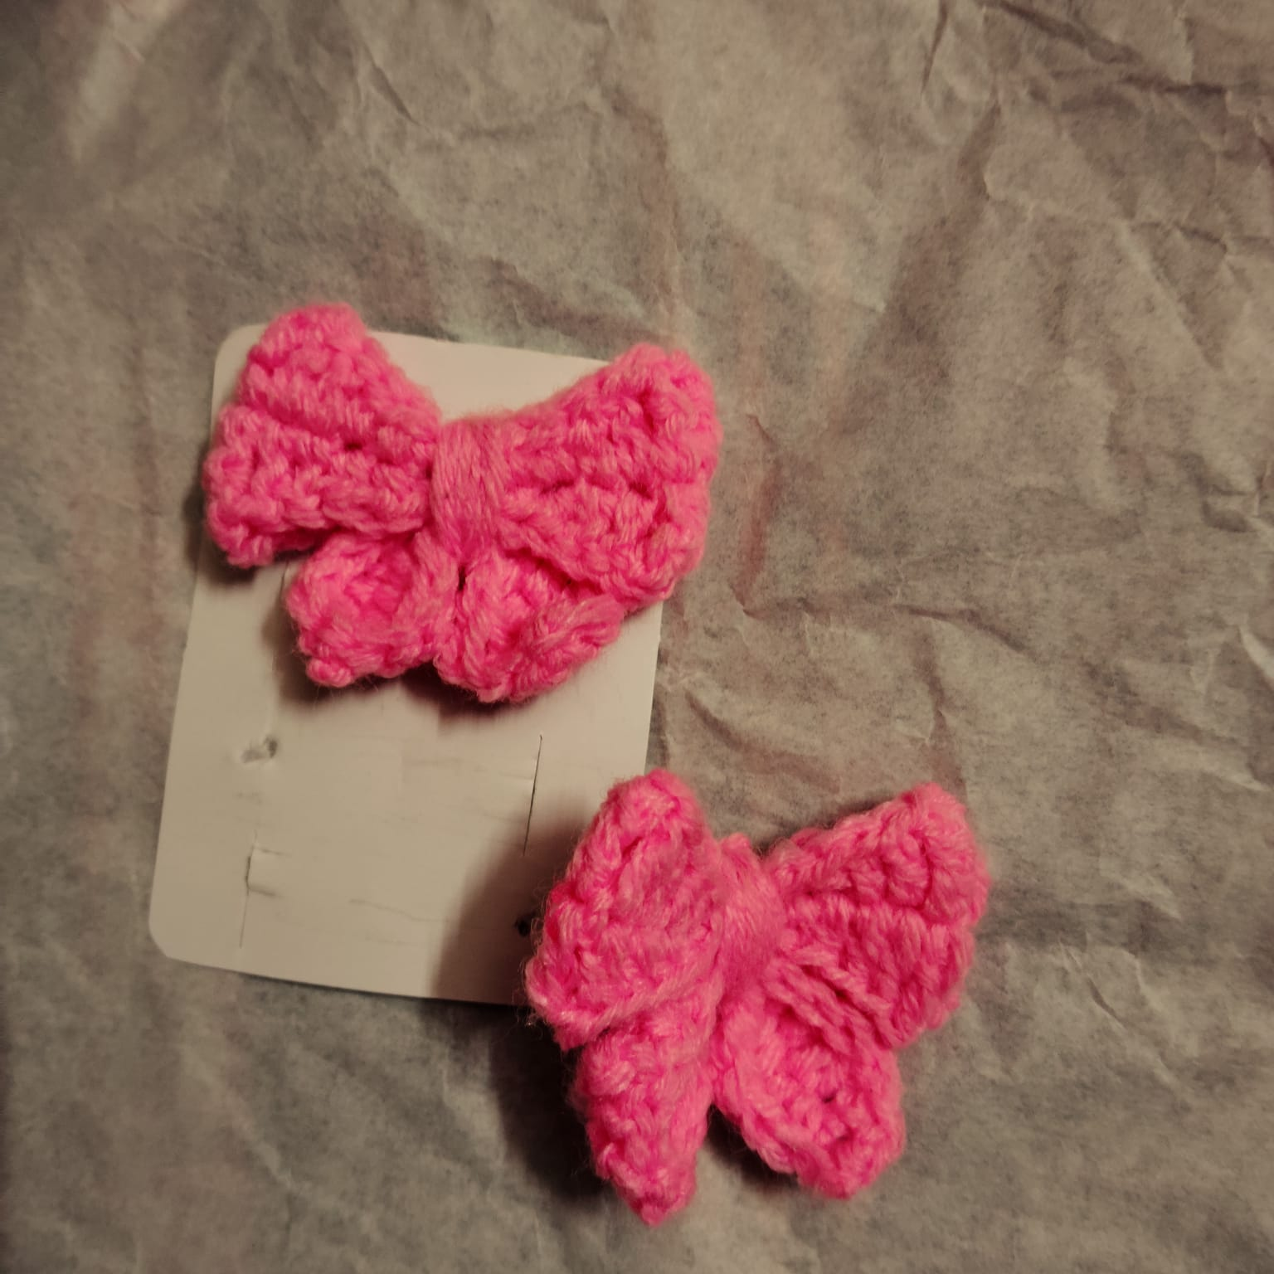
Bow hairclip each Rs 65

Slide 10
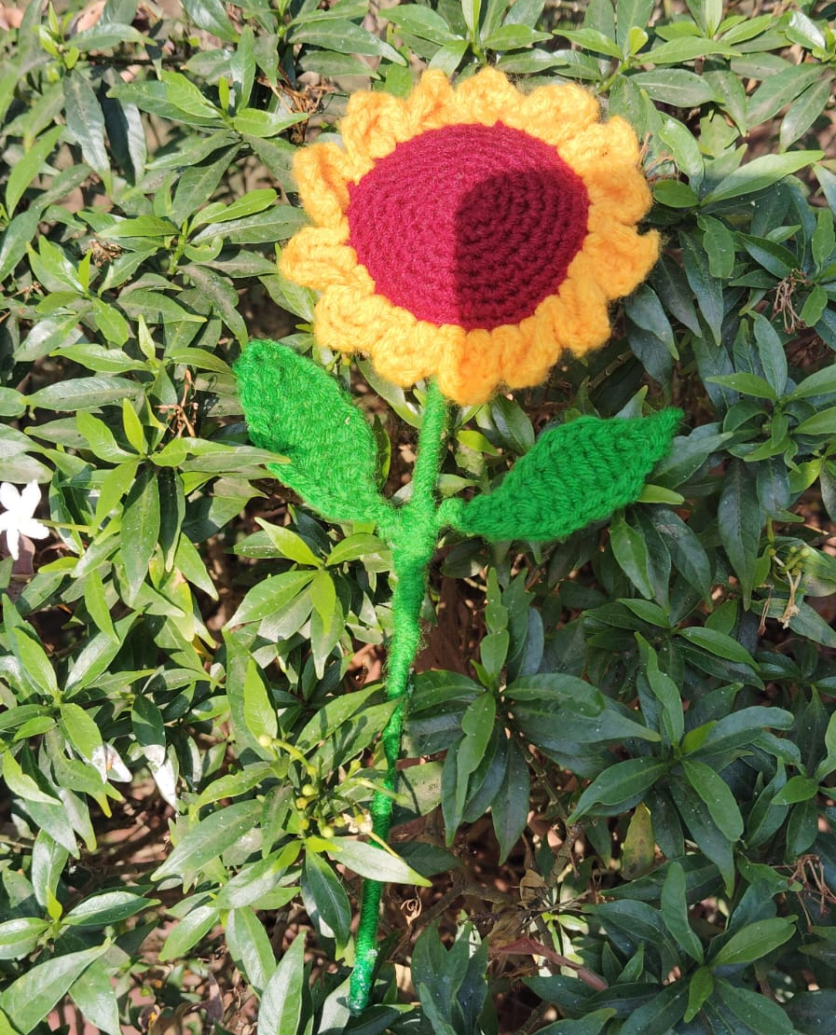
Sunflower Rs 200

Slide 11
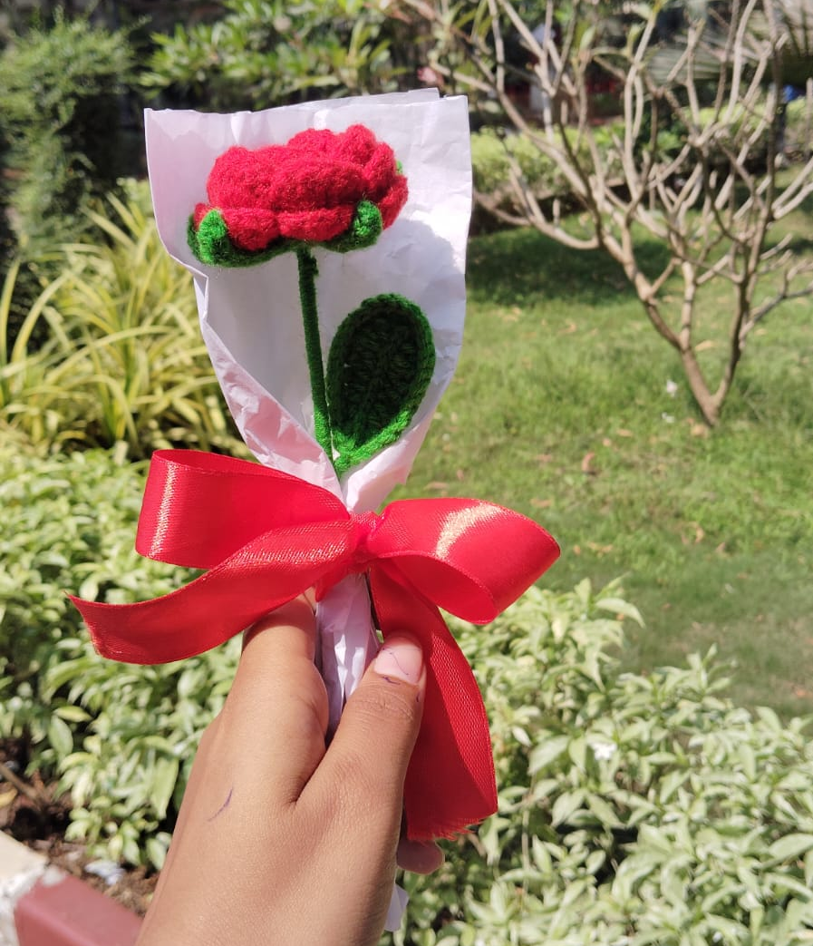
Rose Rs 120

Slide 12
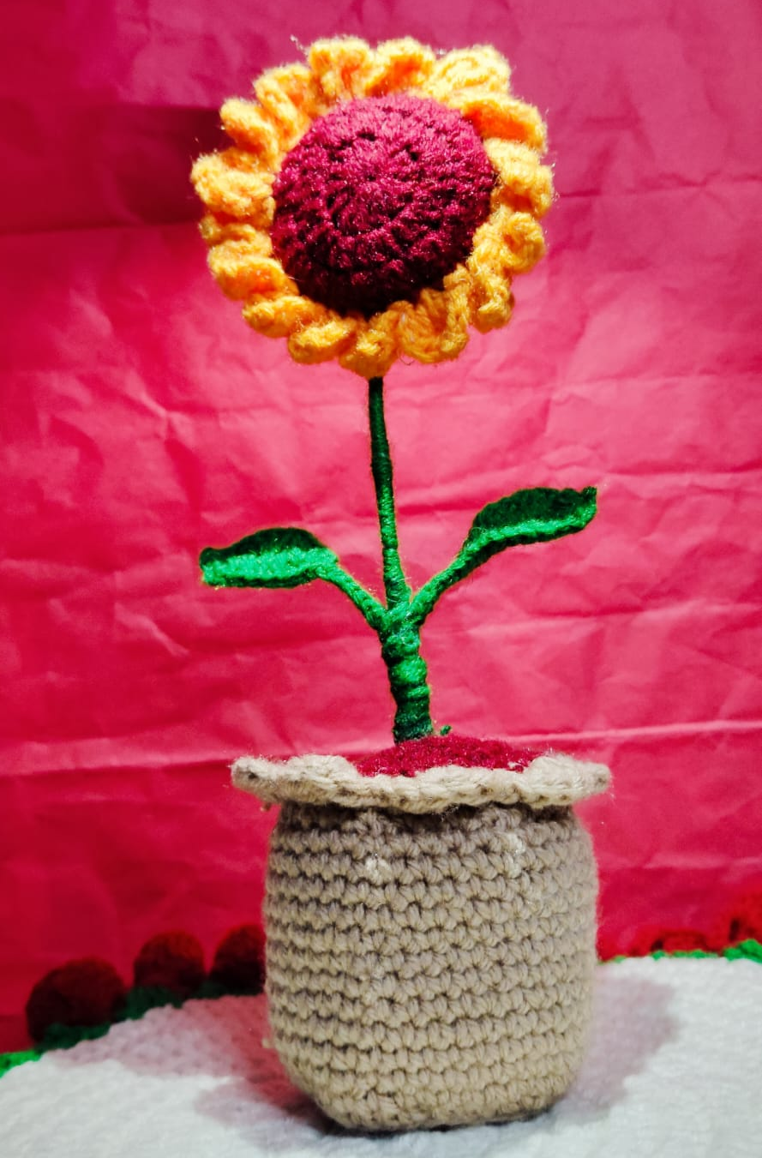
Sunflower pot Rs 500

Slide 13
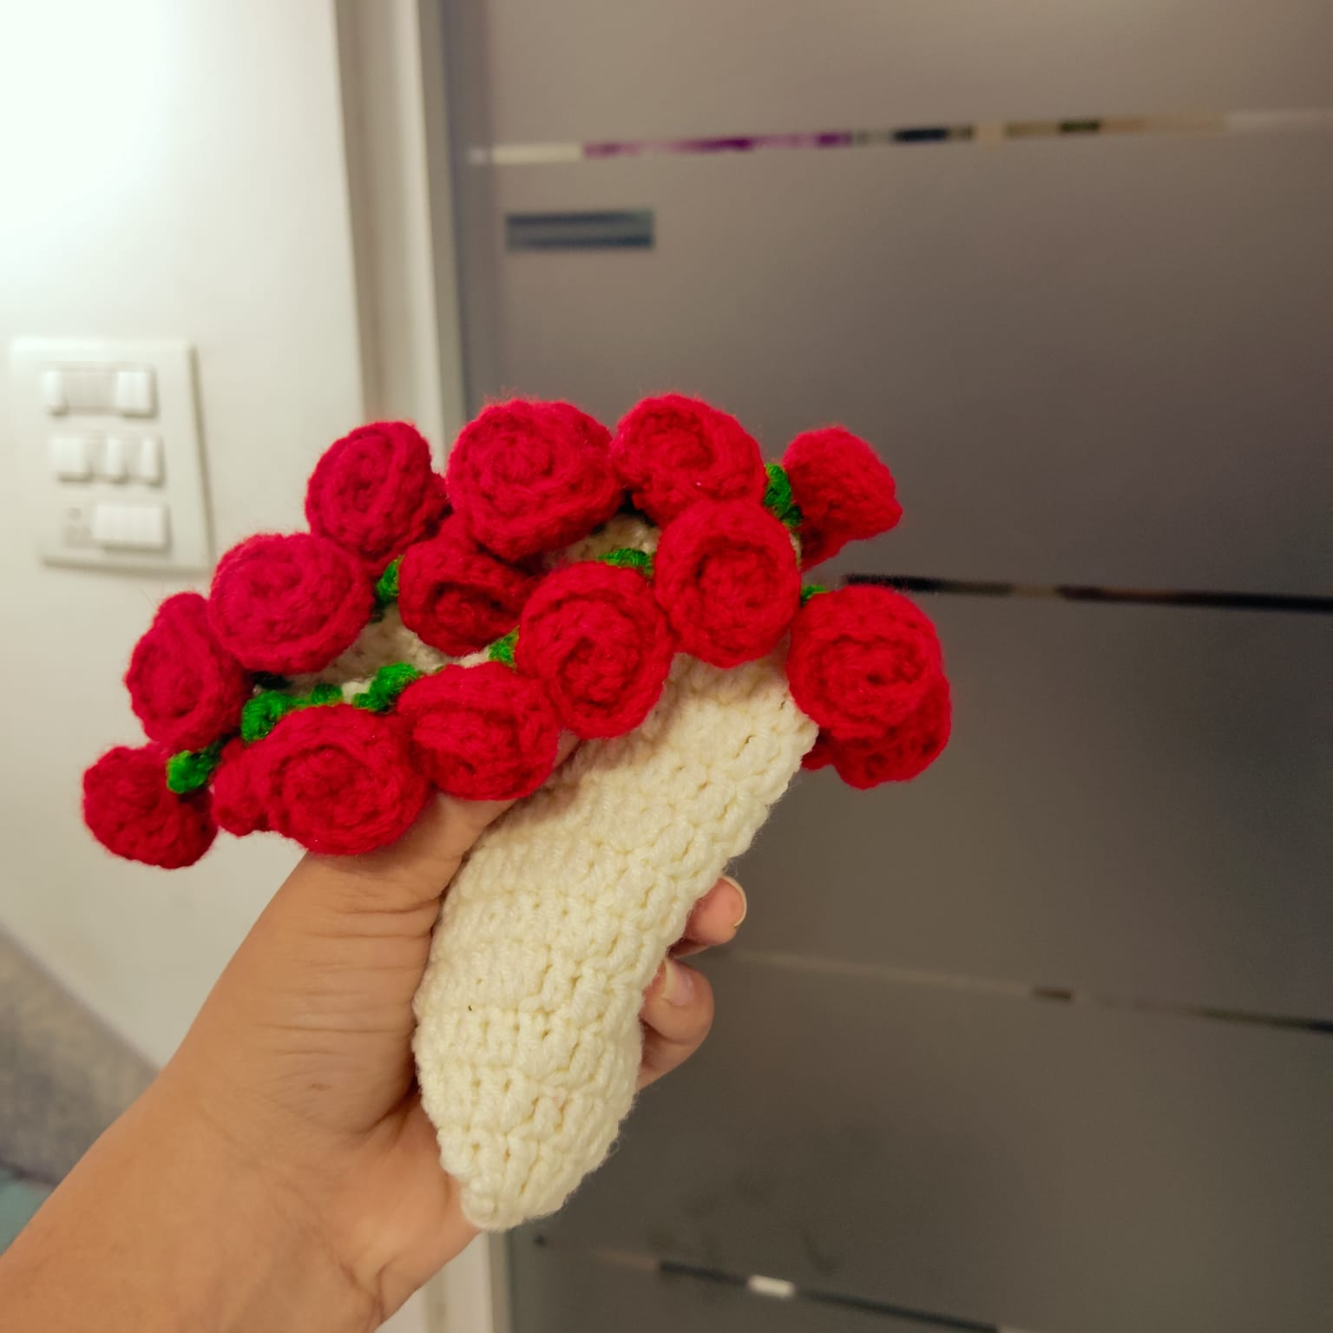
Rose bouquet blanket Rs 999

Slide 14
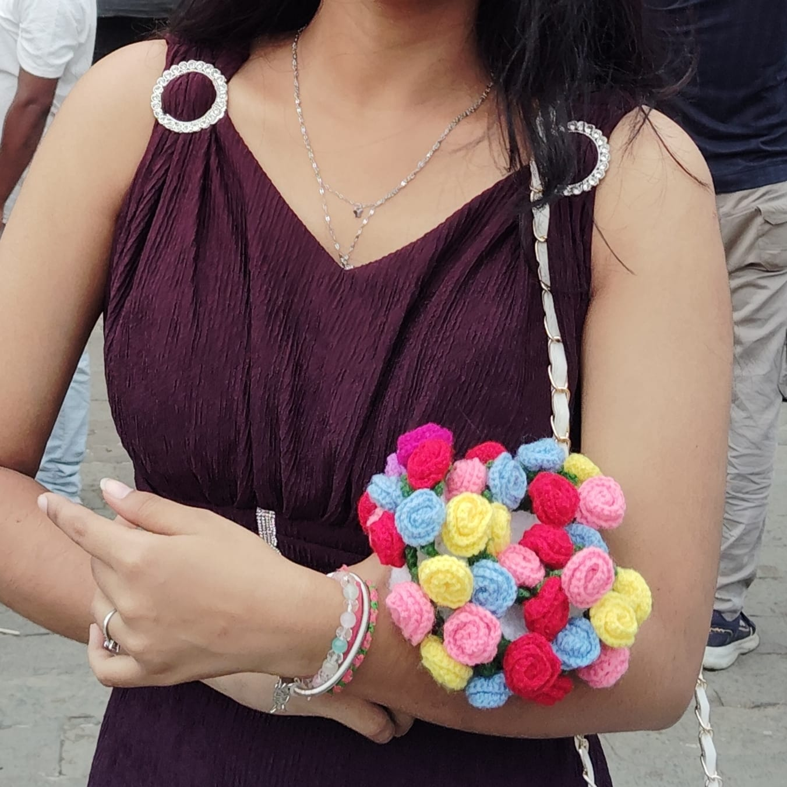
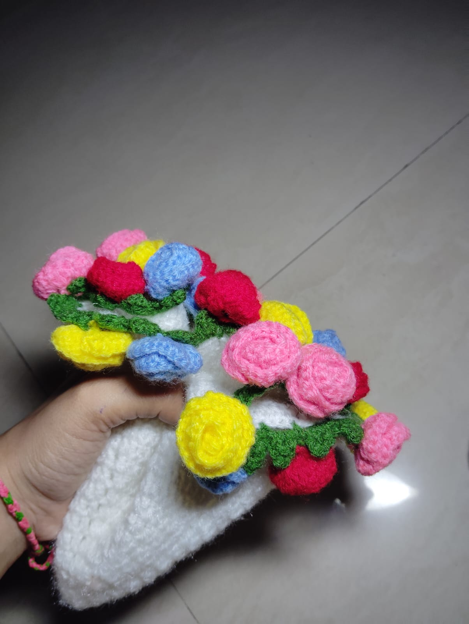
Multicolour rose bouquet blanket Rs 1199

Slide 15
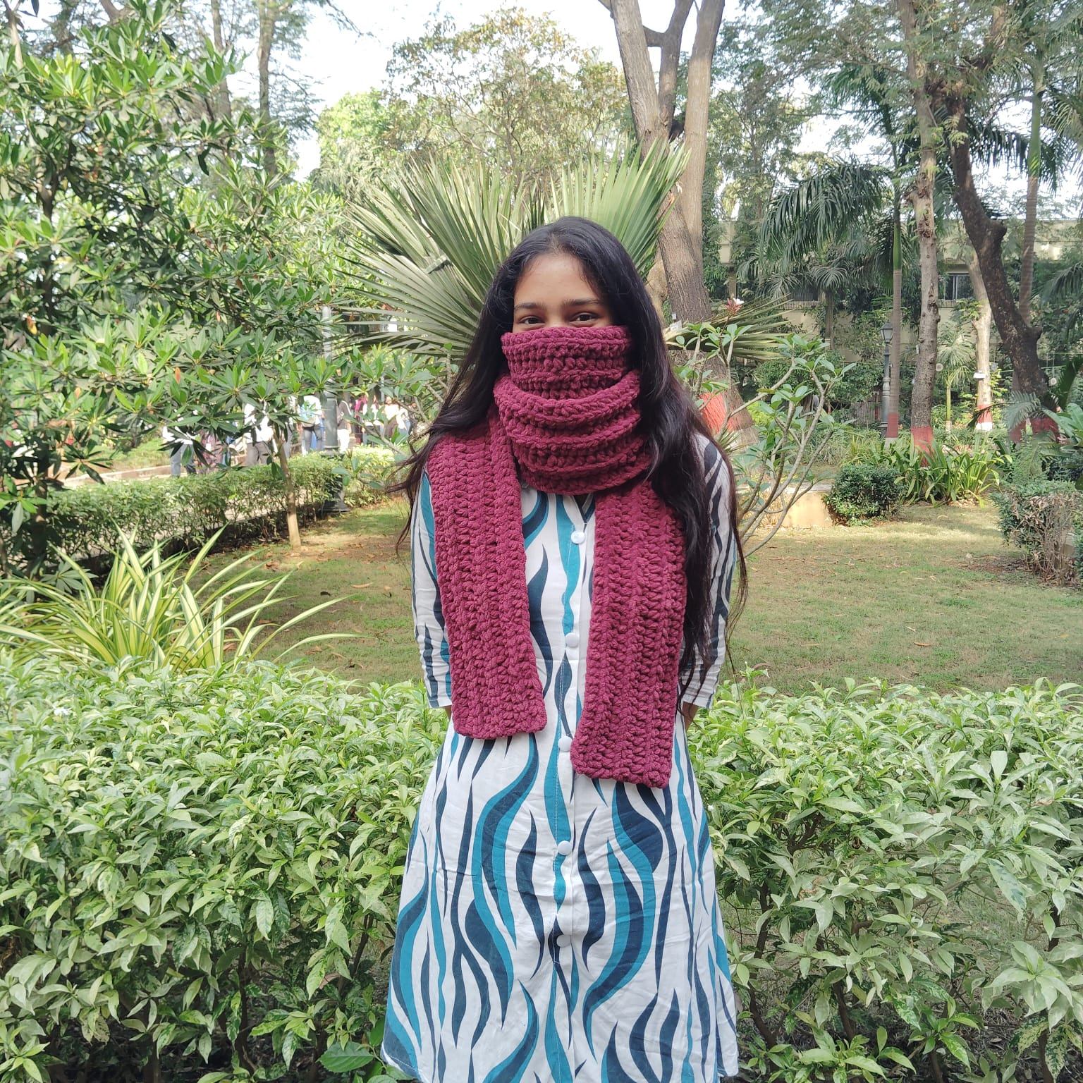
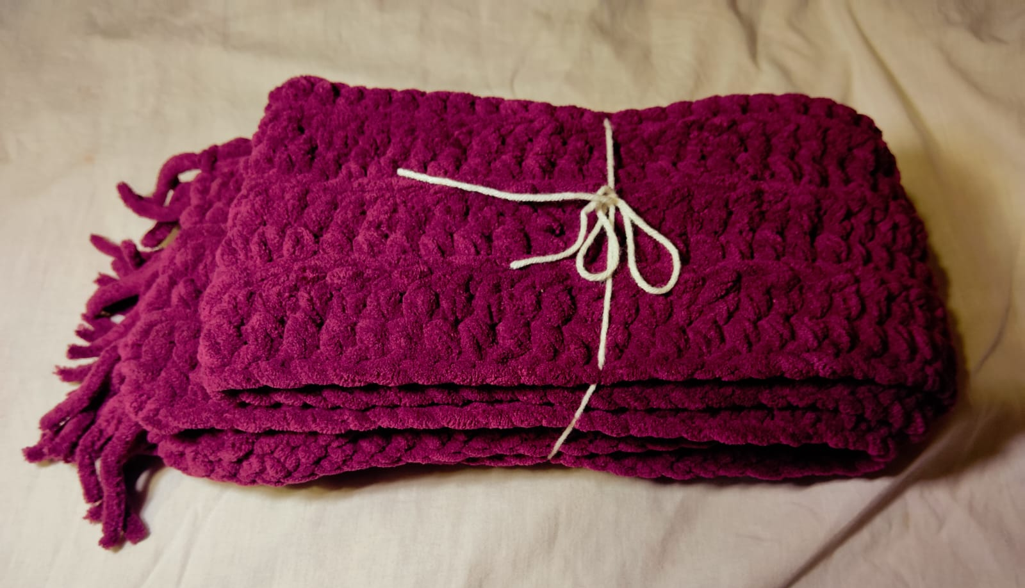
Soft muffler Rs 1299

Slide 16
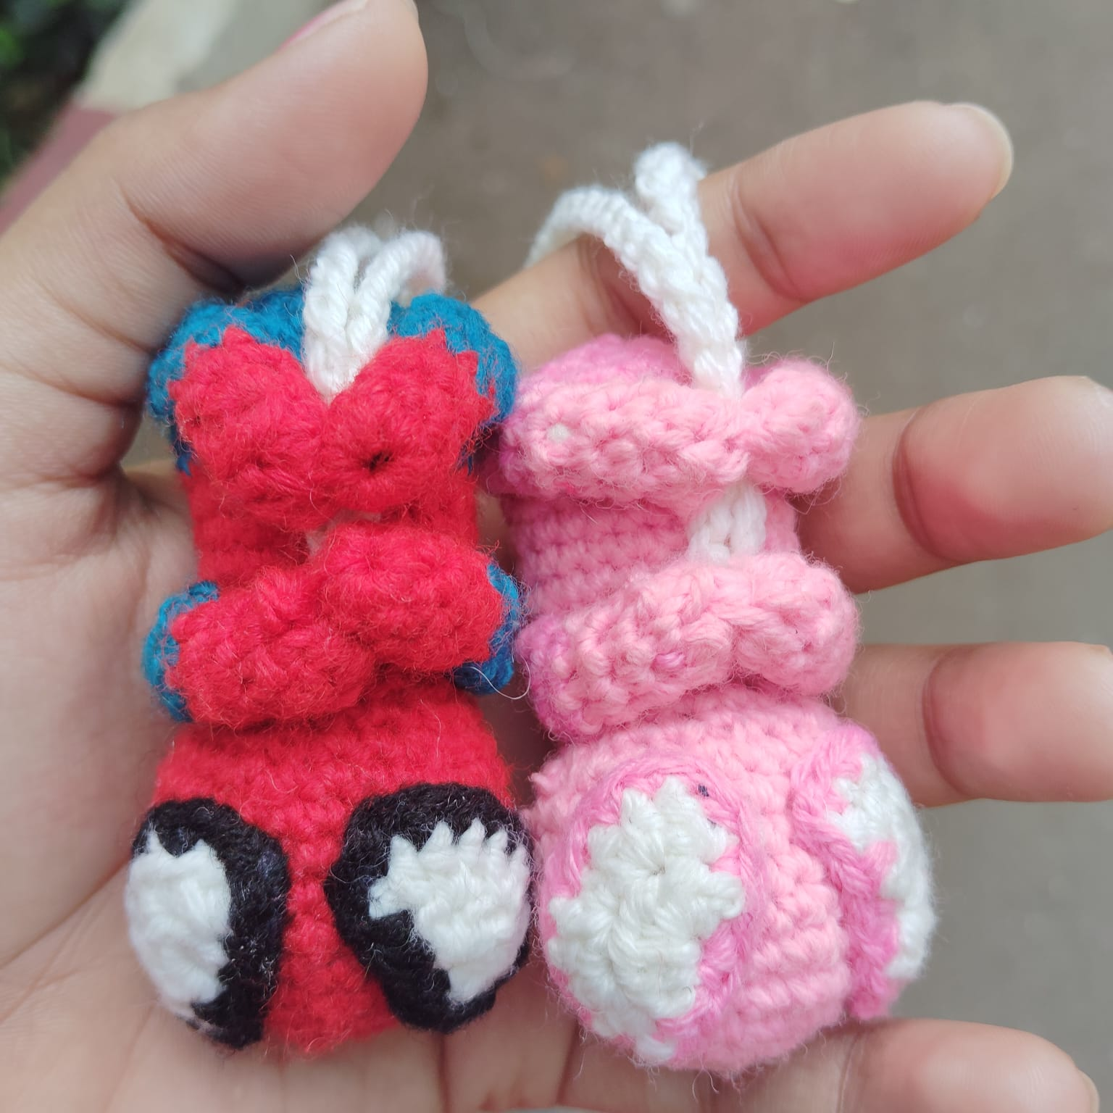
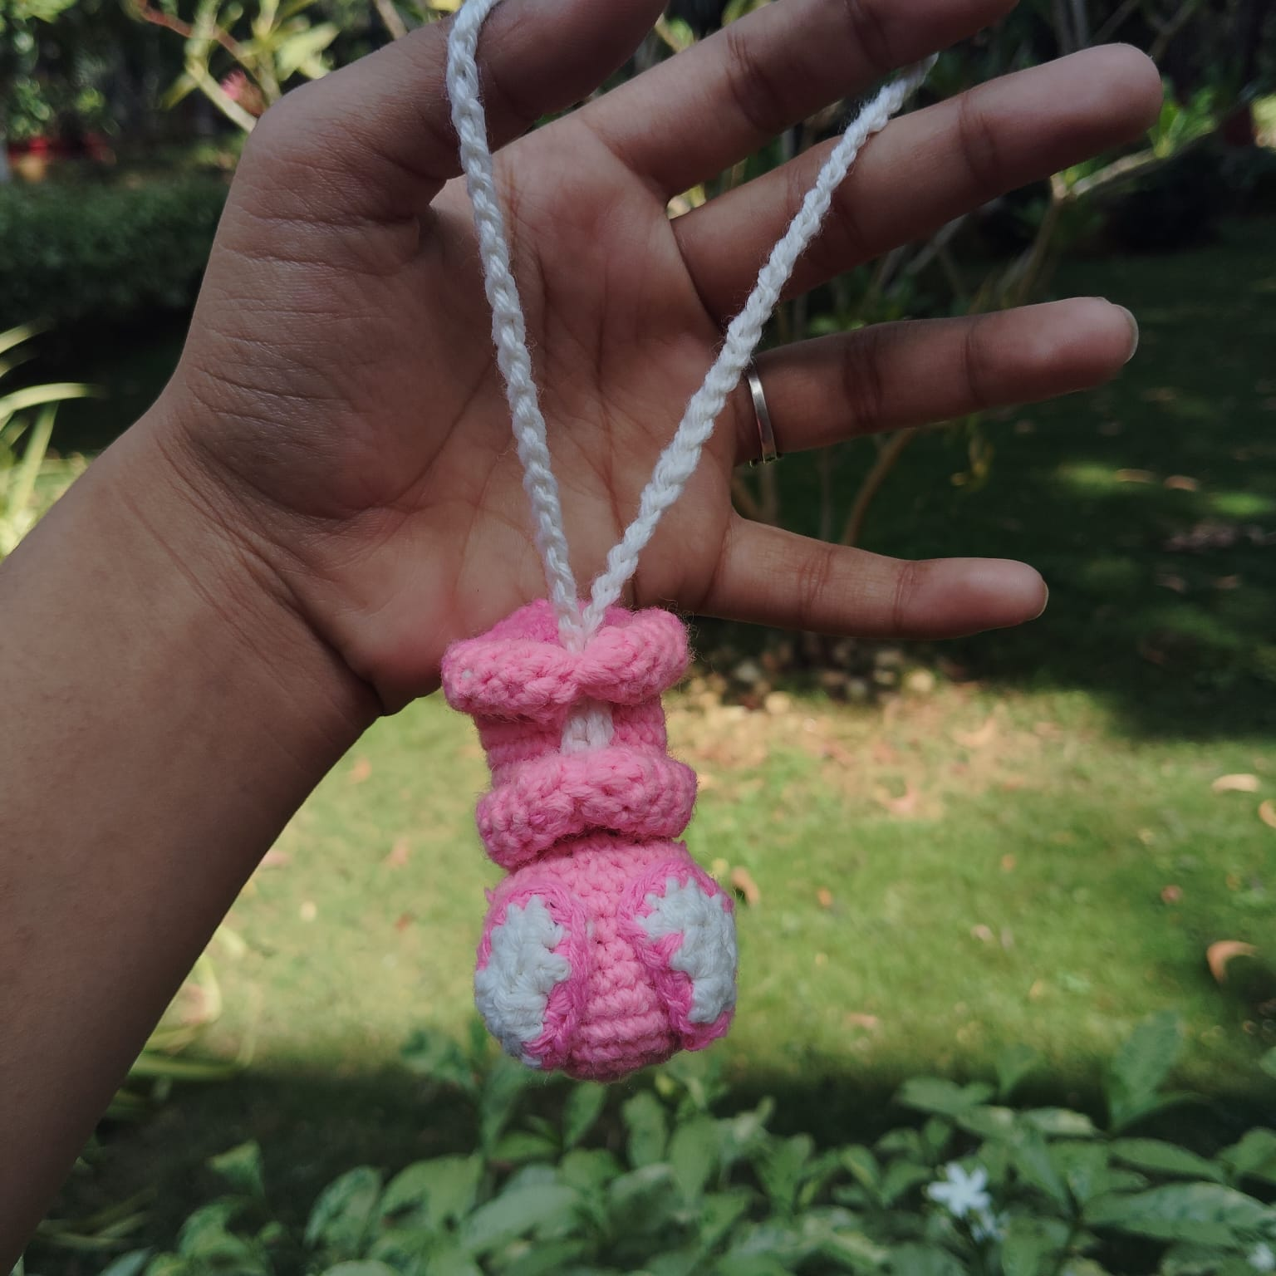
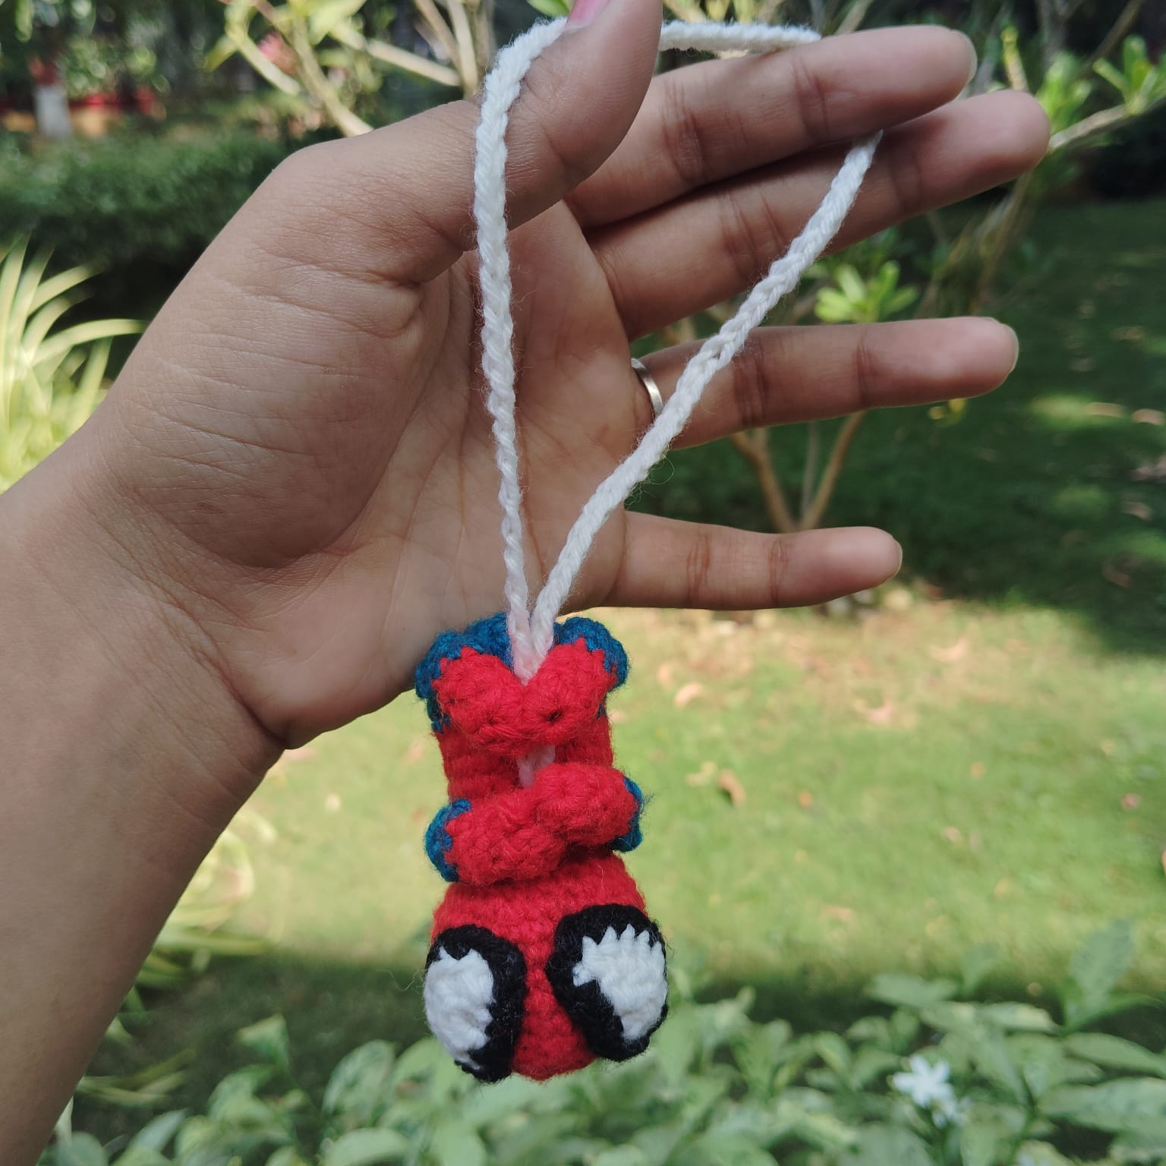
Gwan keychain Rs 300
Spiderman
Rs 300

Slide 17
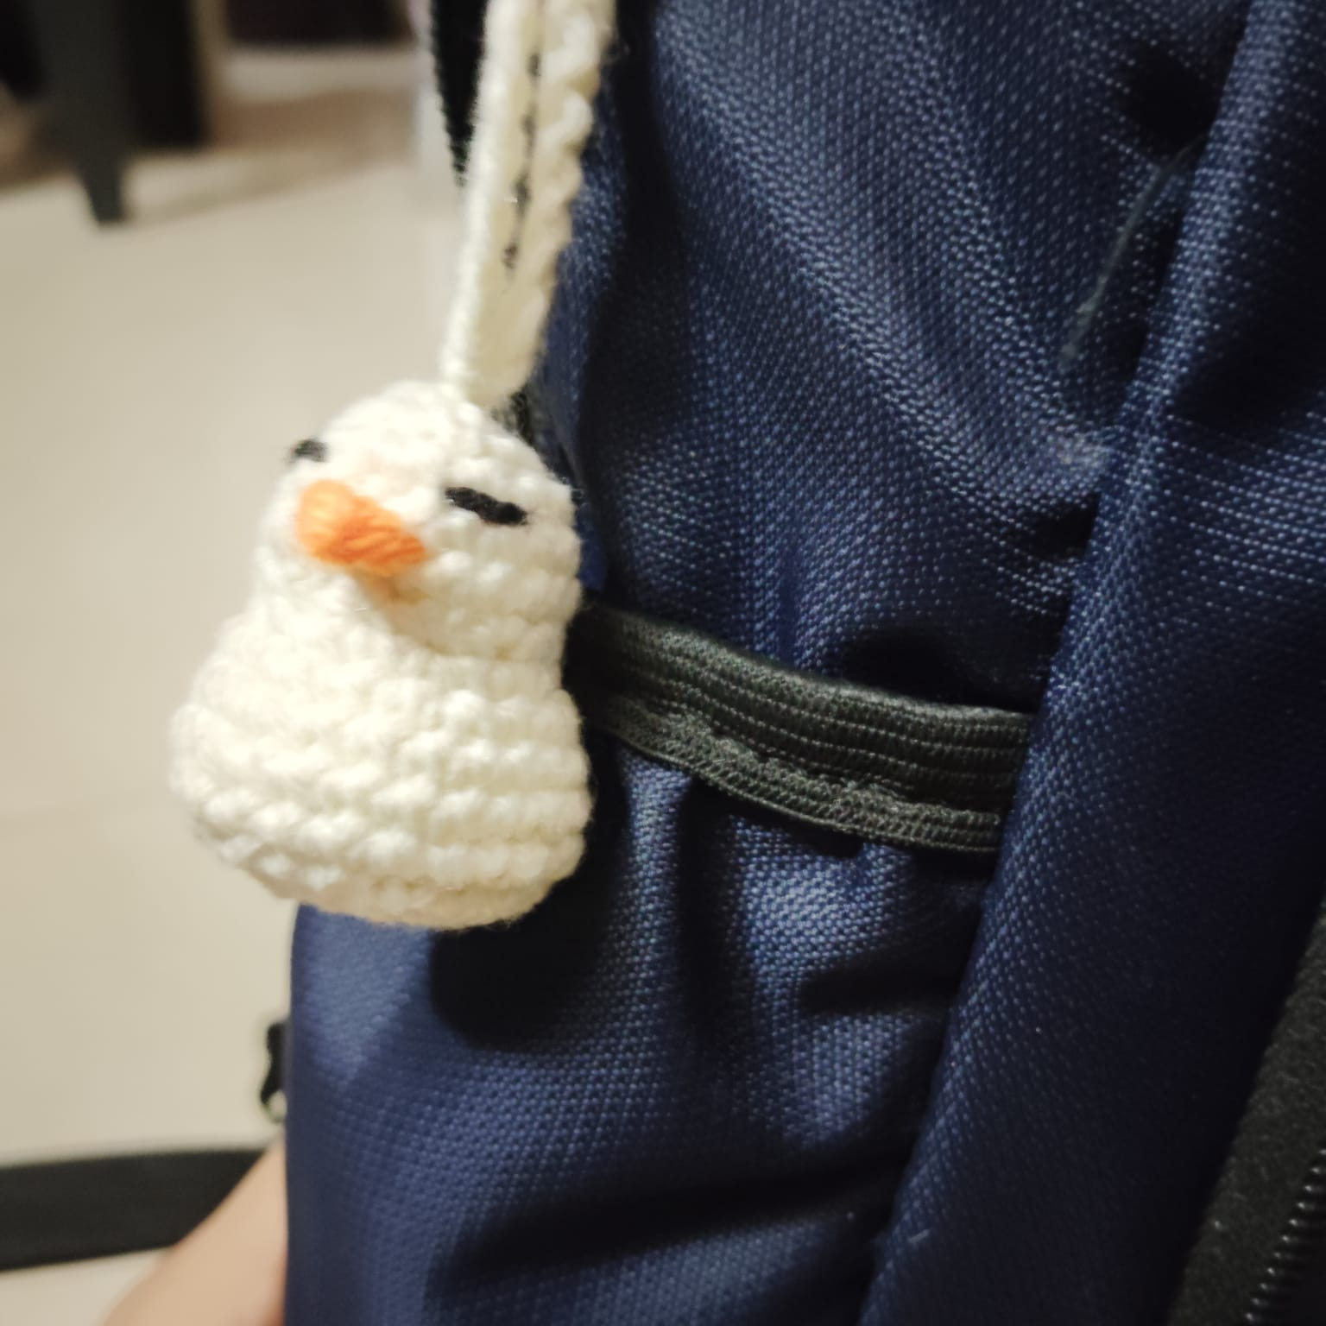
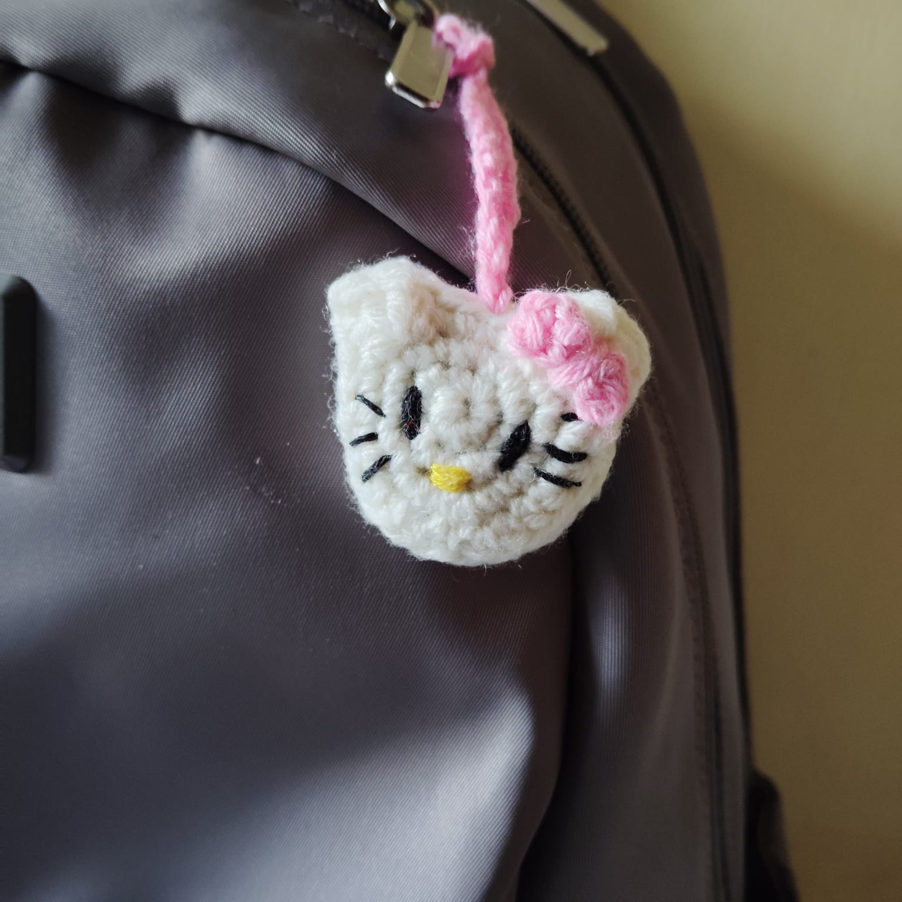
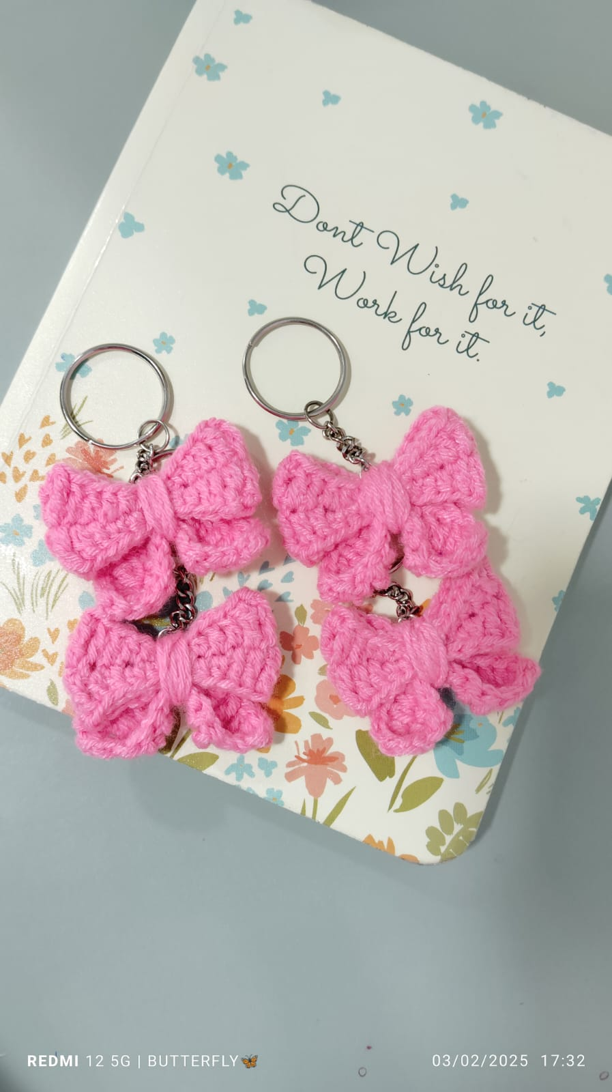
Duck keychain Rs 120
Bow keychain
Rs 70
Kitty
keychain Rs 70

Slide 18
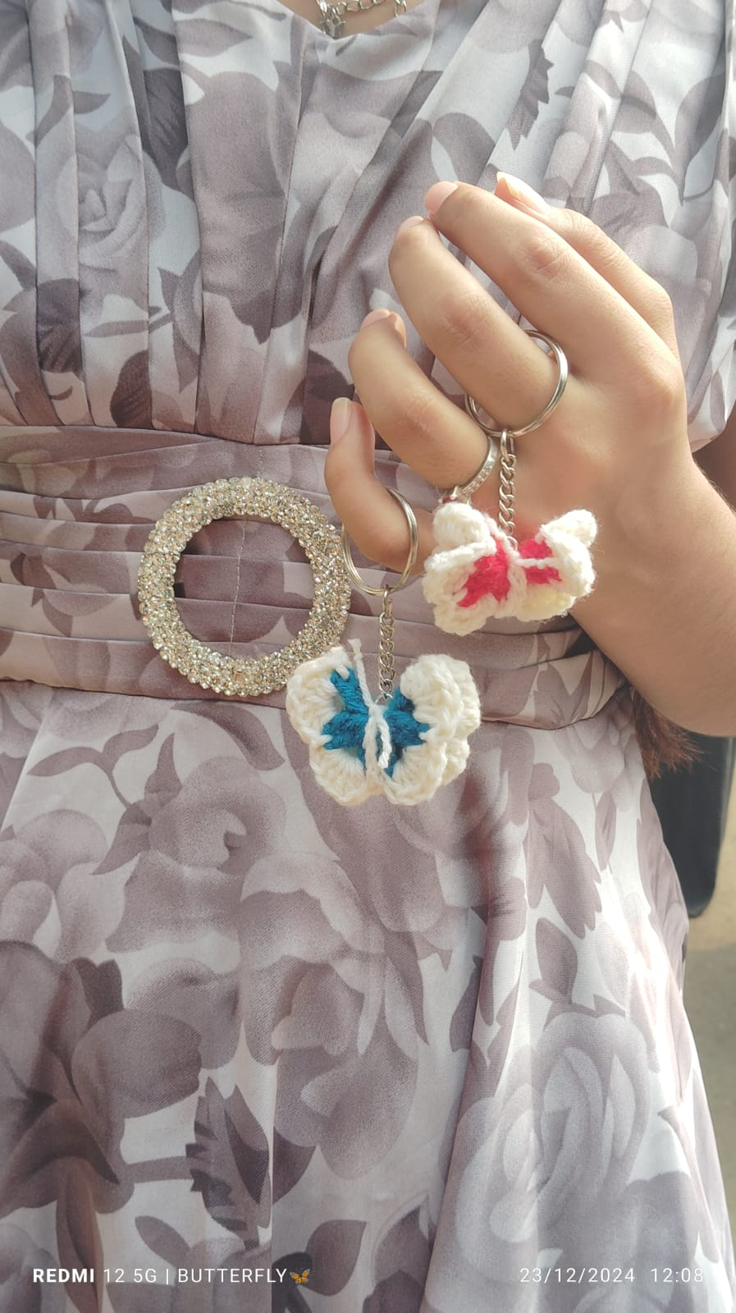
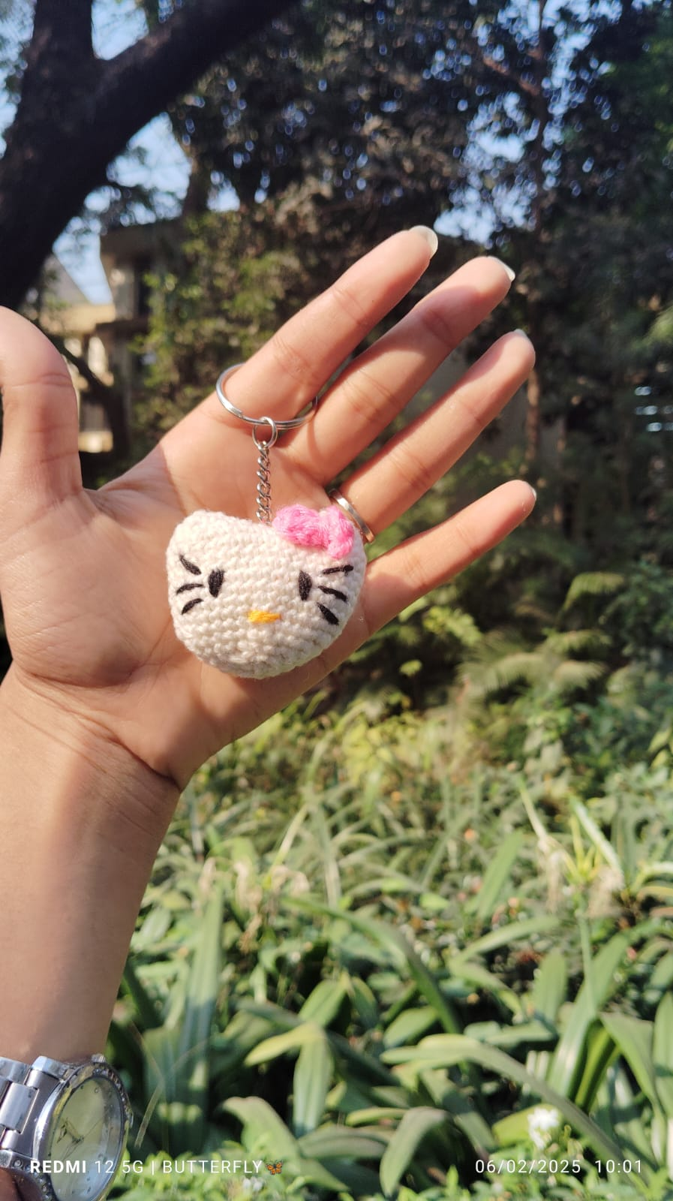
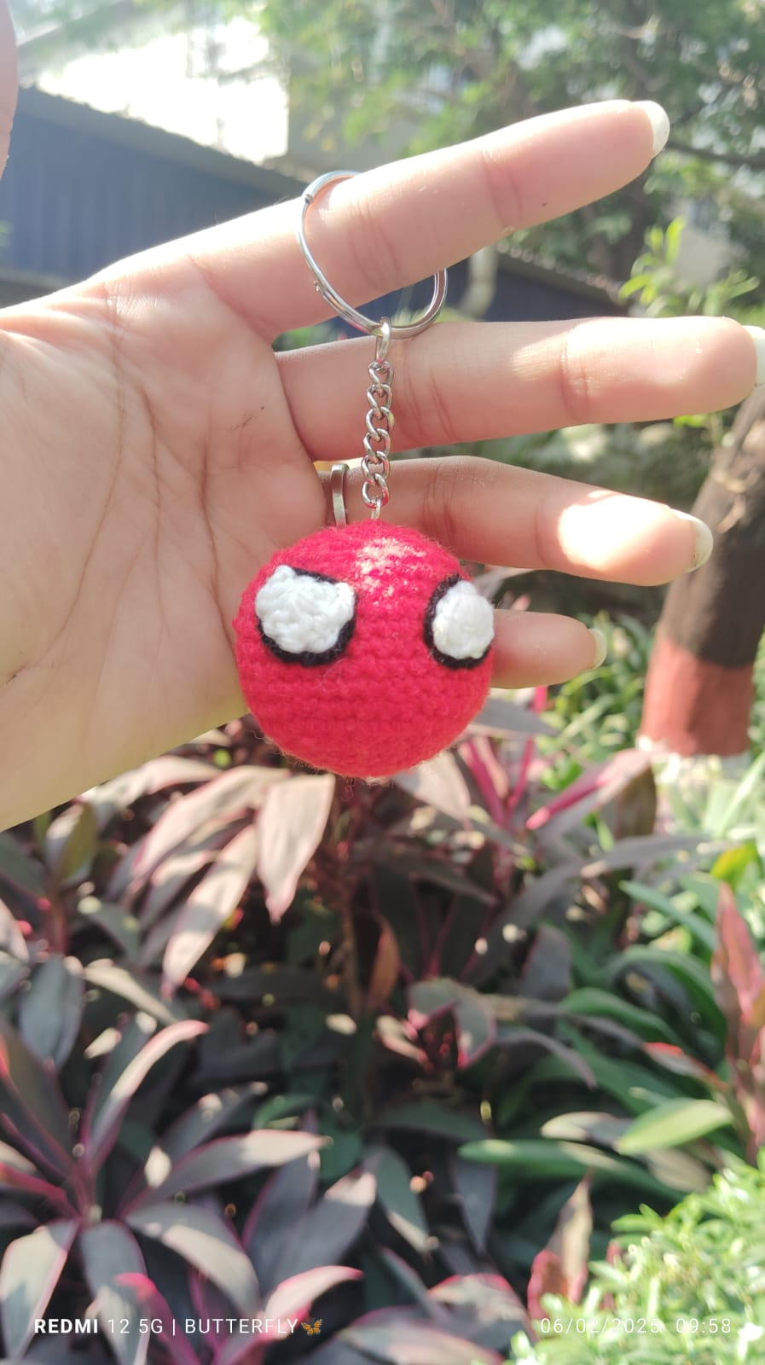
Butterfly
keychain each Rs 50
Kitty
keychain Rs 120
Spiderman
Face
Rs 120

Slide 19
For bookings and orders, please contact us at: Instagram: @crochetwithsneha WhatsApp: +91 9930781598

